Slide 1
Get to know what we do not know
– Seeking a novel approach for the association analysis

Slide 2
Do we know, or do we not know?
There are things we know that we know.
There are known unknowns.
That is to say there are things that we now know we don't know.
But there are also unknown unknowns.
There are things we do not know we don't know
Donald Rumsfeld’s quote at DOD news briefing (02/12/2002)

Slide 3
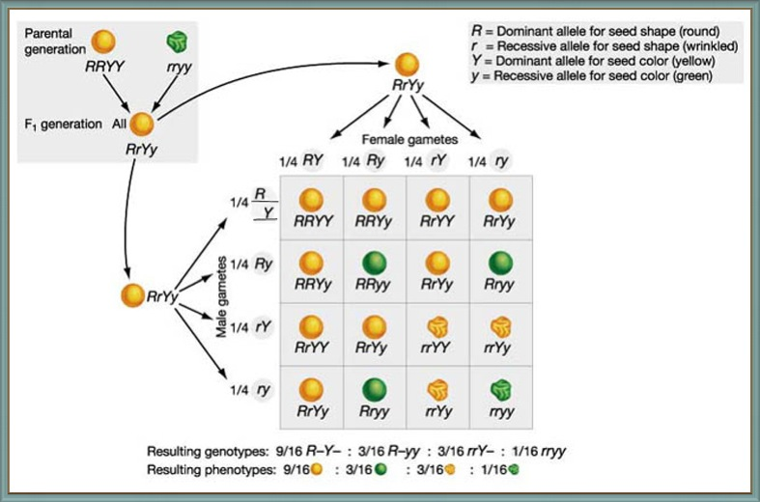
Things we know that we know
Notes:
1860, Gregor Mendel proposed/published Law of Segregation
Mendelian inheritance (on single gene/allel)

Slide 4
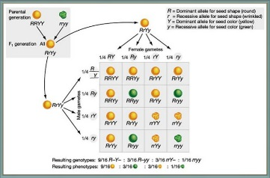
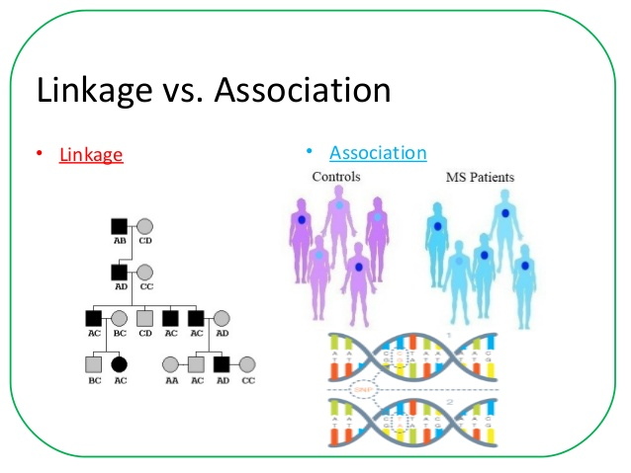
Notes:
Linkage analysis is based on simple Mendelian inheritance and it uses affected relatives (typically siblings) to identify regions on chromosomes that are shared more frequently than expected by chance.
Association studies test for association of genotyped marker (typically single nucleotide polymorphism, SNP) with the disease of interest in a case-control or family-based sample

Slide 5
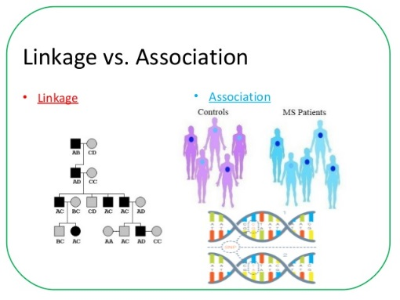
Notes:
Linkage analysis is based on simple Mendelian inheritance and it uses affected relatives (typically siblings) to identify regions on chromosomes that are shared more frequently than expected by chance.
Association studies test for association of genotyped marker (typically single nucleotide polymorphism, SNP) with the disease of interest in a case-control or family-based sample

Slide 6
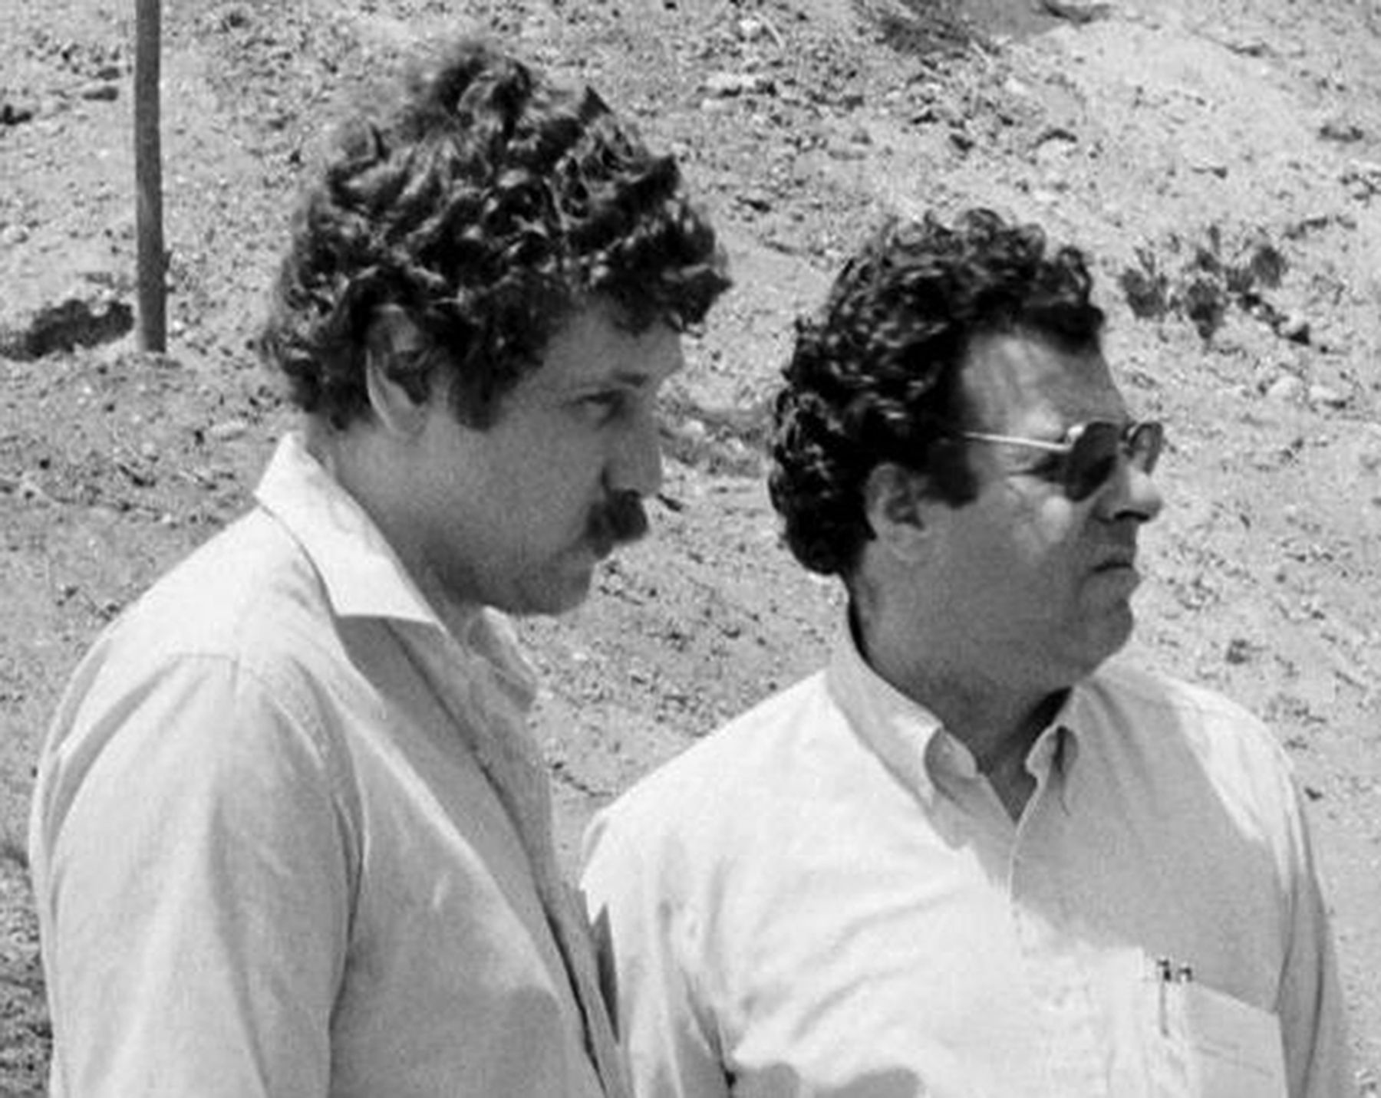

Gary A. Churchill Genetics 2016;203:1-3
Copyright © 2016 by the Genetics Society of America
Notes:
Mendelian inheritance was rediscovered at the beginning of the 20th century
QTL: A chromosomal segments that contribute to variation in a quantitative phenotype
Another interest of statistical geneticists using QTL mapping is to determine the complexity of the genetic architecture underlying a phenotypic trait.
1989, Lander and Botstein developed interval mapping and Composite interval mapping

Slide 7
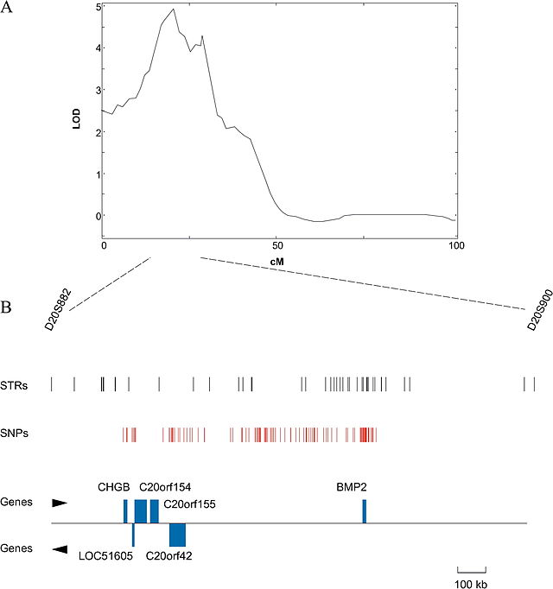
Notes:
A quantitative trait locus (QTL) is a section of DNA (the locus) which correlates with variation in a phenotype (the quantitative trait)
Usually the QTL is linked to, or contains, the genes which control that phenotype
QTLs are mapped by identifying which molecular markers (such as SNPs or AFLPs) correlate with an observed trait.

Slide 8


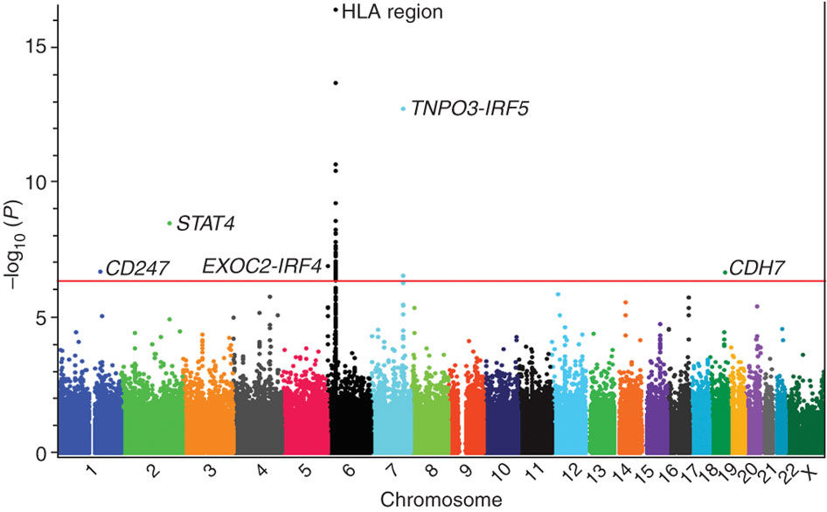
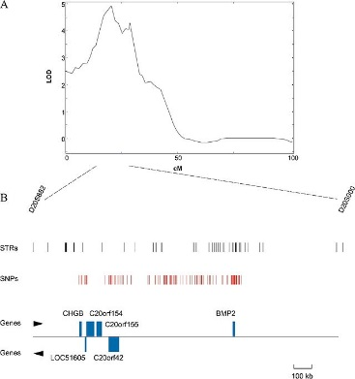
Gary A. Churchill Genetics 2016;203:1-3
Things we know that we know
Radstake, T.R et al Nature Genetics, 42, 426–429 (2010) doi:10.1038/ng.565
Notes:
Since 2001, human genome sequence was published,
2003: HapMap was 99% done,
GWAS is an examination of a genome-wide set of genetic variants in different individuals to see if any variant is associated with a trait. A genome-wide association study in a autoimmune disease “Systemic sclerosis ” in a population of European ancestry including a total of 2,296 individuals with SSc and 5,171 controls.

Slide 9
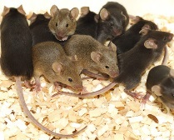
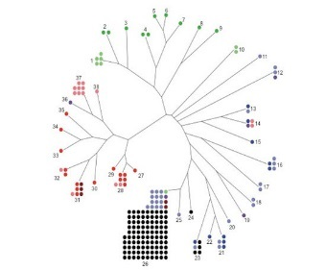
What do we have and what do we know
An animal model to study the lung injury upon exposure to high density oxygen (hyperoxia)
For new born babies with bronchopulmonary dysplasia (BPD)
A collection of 223 mouse strains represent seven major lineages inbred/wild derived mice
Neonate mouse with exposure serve as the animal model
All been genotyped for ~630,000 SNPs
Selected strains in the experiment are exposed to
Normal air
High density oxygen (hyperoxia)
A series of acute lung injury phenotypes
A new nomenclature – NuVar
Notes:
A acute and chronic pulmonary disorders,
New born babies with bronchopulmonary dysplasia (BPD) given high density oxygen

Slide 10
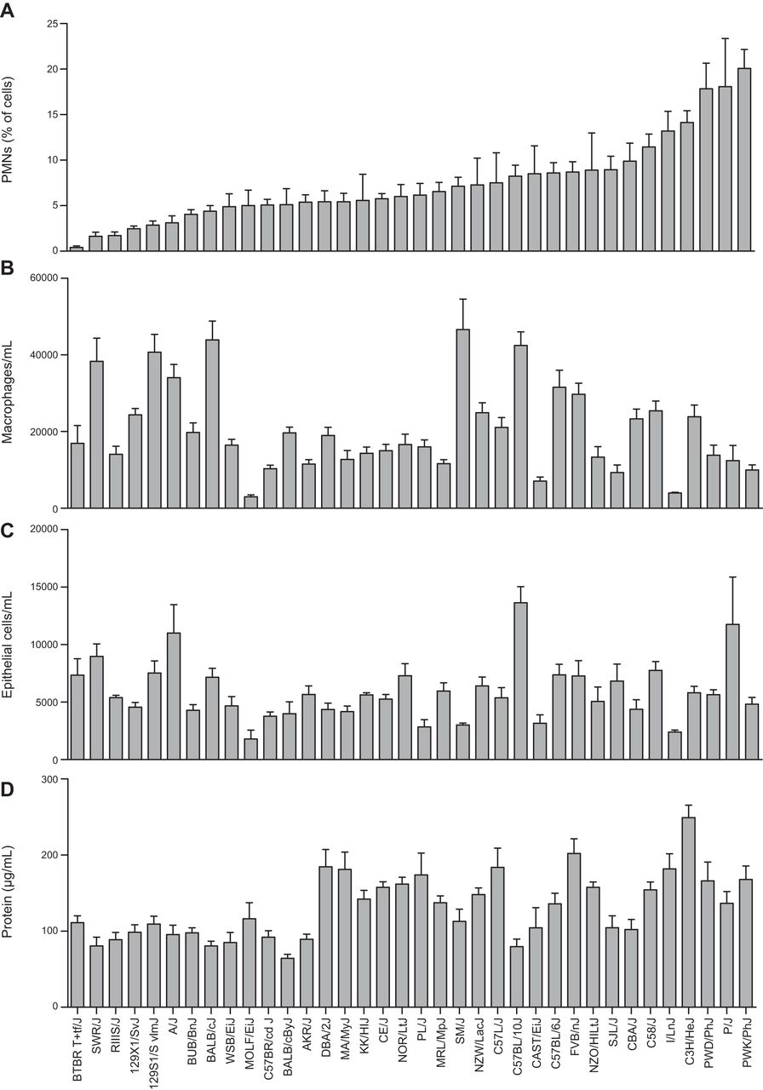
Strain distribution patterns of lung injury phenotypes from BALF after 72 h exposure to hyperoxia
Jennifer L. Nichols et al. FASEB J 2014;28:2538-2550
Notes:
Strain distribution patterns of lung injury phenotypes from BALF after 72 h exposure to hyperoxia. A) PMNs as a percentage of BALF total cells. B) Macrophages per milliliter BALF. C) Epithelial cells per milliliter BALF. D) Protein concentration in BALF). Bars represent means ± sem (n=5–28/strain).

Slide 11
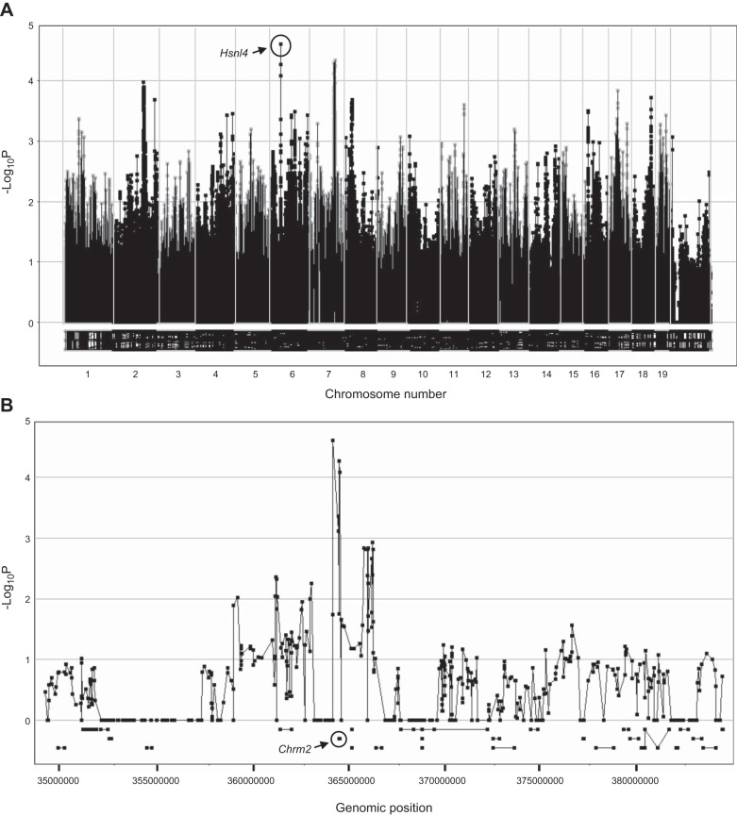
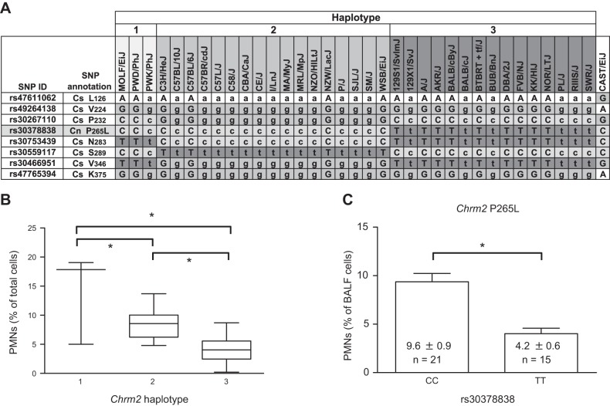
A deletion associated with the hyperoxia-induced lung injury
Nichols, J et al FASEB, 28, 2538–2550 (2014) doi:10.1096/fj.13-247221
Notes:
Further, hyperoxia-induced lung injury was significantly reduced in neonatal mice with targeted deletion of Chrm2, relative to wild-type controls. This study has important implications for understanding the mechanisms of oxidative lung injury in neonates

Slide 12
We extended what we know
Ultra-deep sequencing on mitochondrial genome (mouse strains)
Total 665 SNPs – MitoVar
Heteroplasmy status
New phenotypes of interest
DNA lesion
MitoDNA lesion
DNA copy number changes
Etc.
VarStat | MajorAllele | MinorAllele | HetVar Stat
AbsRef | Reference | NA | 0
AbsSNV | Alternative | NA | 1
Heteroplasmy | Reference | Alternative | 2
Heteroplasmy | Alternative | Reference | 3

Slide 13
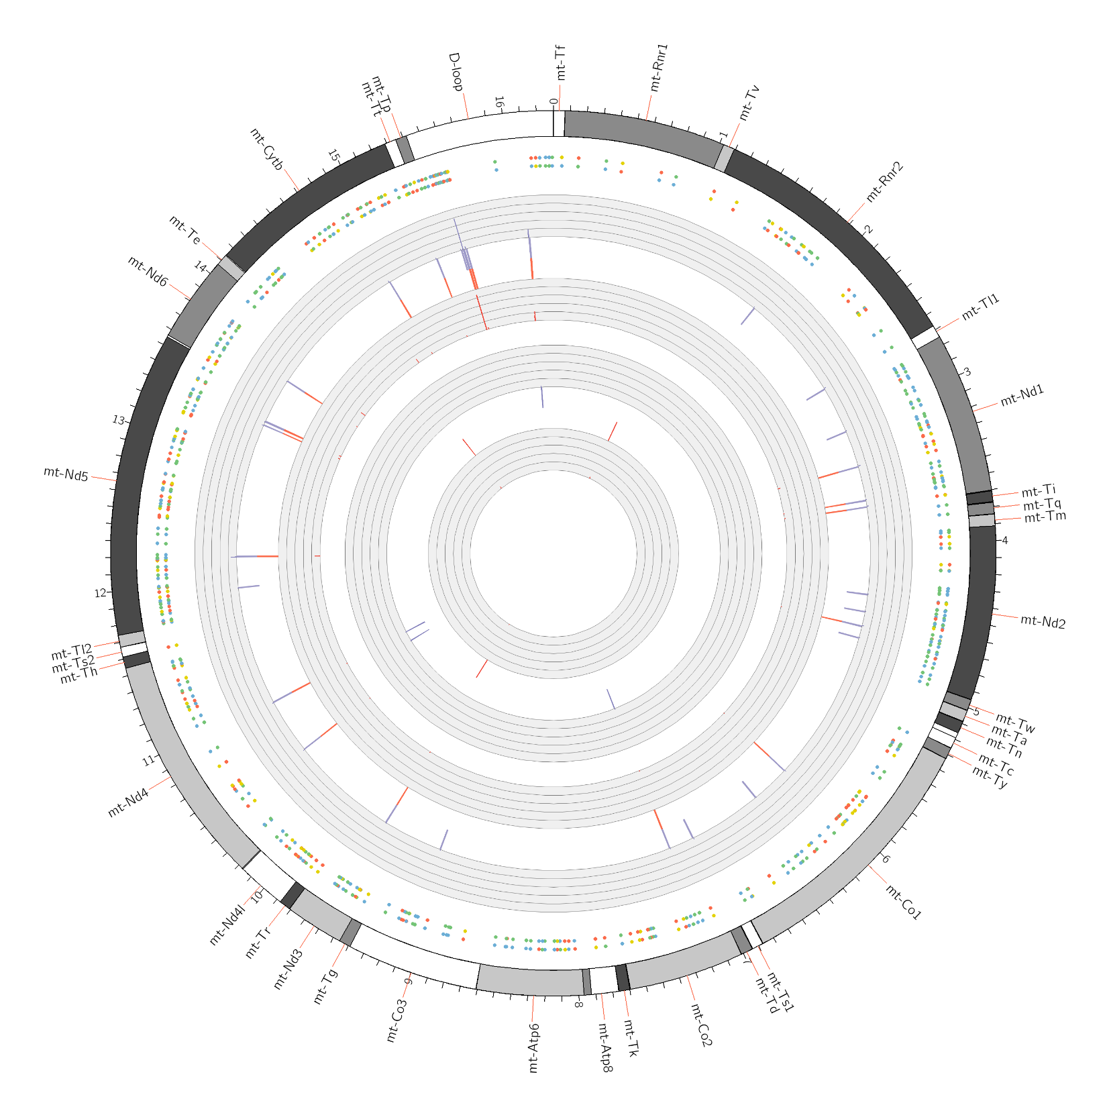
Sara Grimm

Slide 14
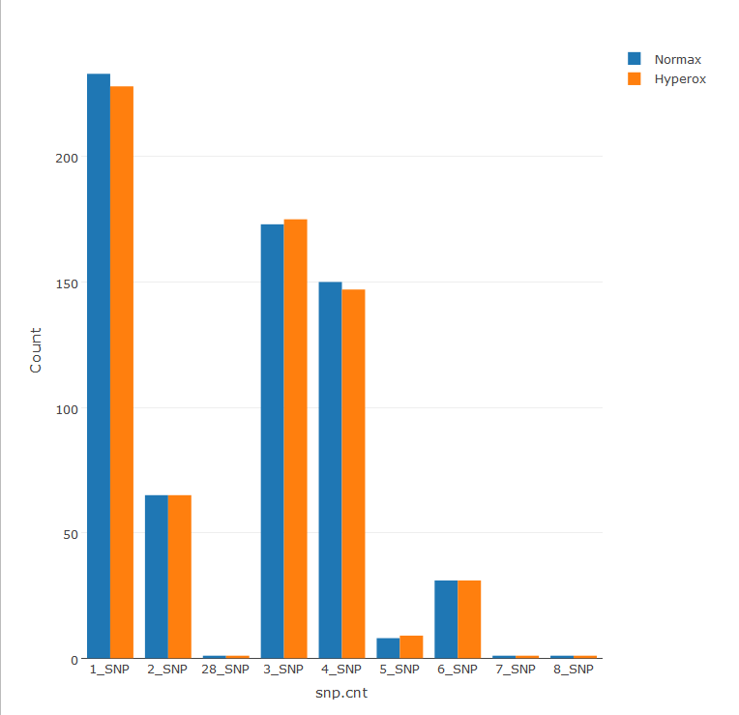
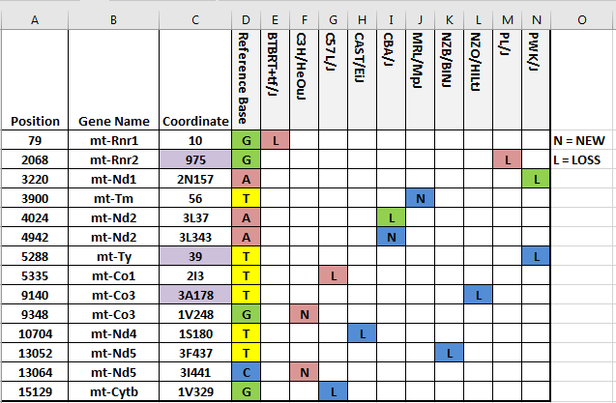
MitoVar (SNP) overview

Slide 15
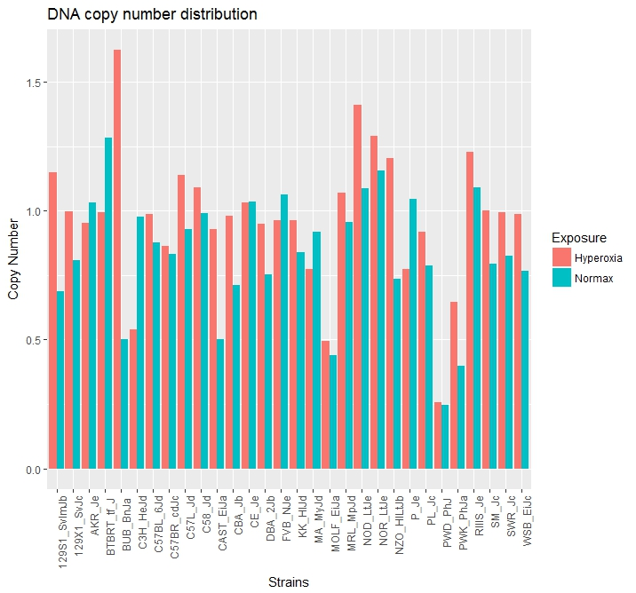
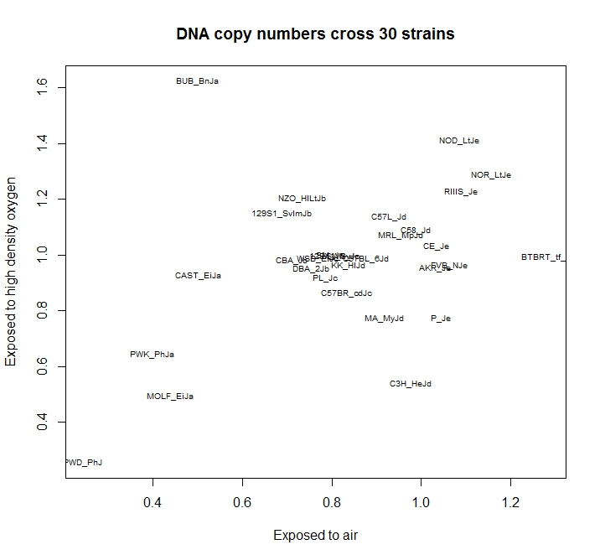
DNA copy number
r=0.3907

Slide 16
Get to know what we do not know
There are things we know that we know.
There are known unknowns.
That is to say there are things that we now know we don't know.
But there are also unknown unknowns.
There are things we do not know we don't know
Donald Rumsfeld’s quote at DOD news briefing (02/12/2002)
What do we not know?
How do we get to know what we do not know?

Slide 17
What do we not know
Any genetic information exists in the sparse MitoVar panel?
Mendelian assumption may not be held
Hardy Weinberg equilibrium
Additive effect vs. multiplicative effects
Is there enough heritability?
Do we have enough statistical power ?
Huge number of statistical tests
How big is the computational stress?
Can we afford the multiple testing issues?
Notes:
We have limited sample size,

Slide 18
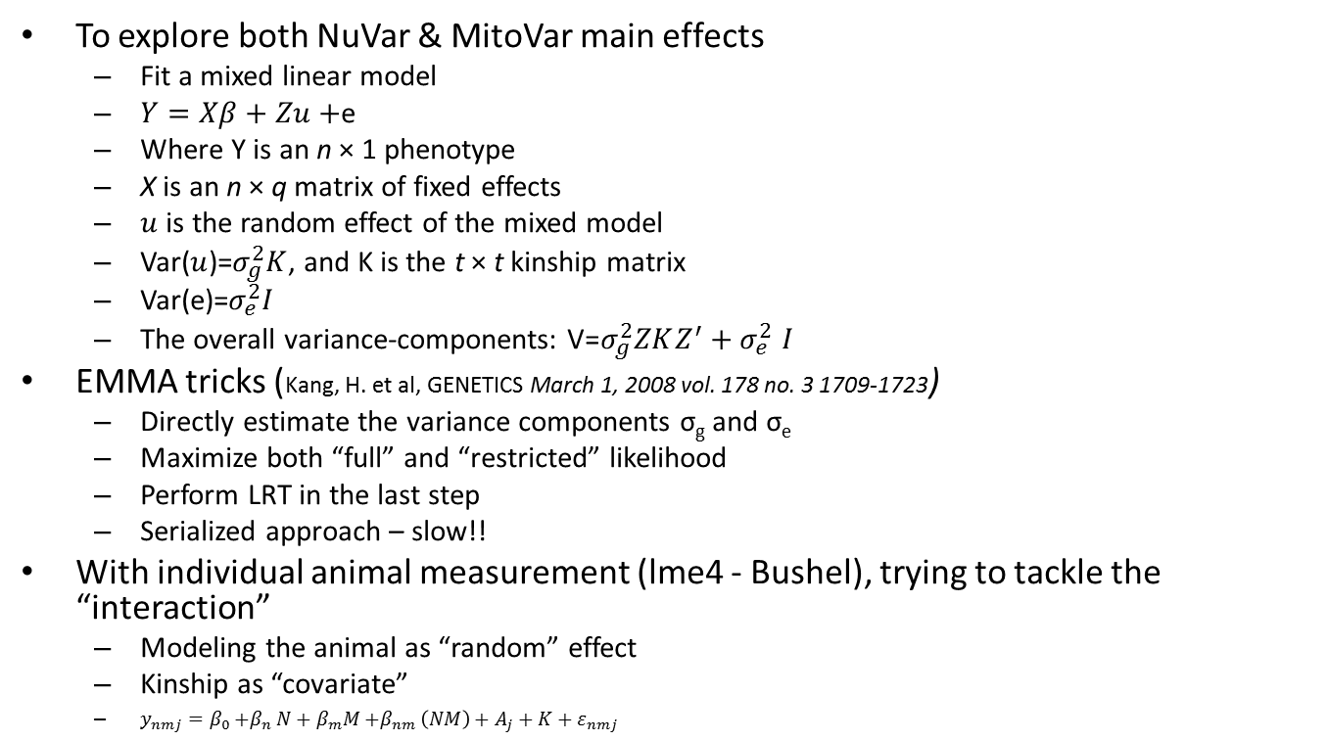
From unknown to known
To explore both NuVar & MitoVar main effects
Fit a mixed linear model
$Y=Xβ+Zu+$e
Where Y is an n × 1 phenotype
X is an n × q matrix of fixed effects
$u$ is the random effect of the mixed model
Var($u$)=$σ_{g}^{2}K$, and K is the t × t kinship matrix
Var(e)=$σ_{e}^{2}I$
The overall variance-components: V${\text{=}σ_{g}^{2}ZKZ^{′}+σ}_{e}^{2}I$
EMMA tricks (Kang, H. et al, GENETICS March 1, 2008 vol. 178 no. 3 1709-1723)
Directly estimate the variance components σ_{g} and σ_{e}
Maximize both “full” and “restricted” likelihood
Perform LRT in the last step
Serialized approach – slow!!
With individual animal measurement (lme4 - Bushel), trying to tackle the “interaction”
Modeling the animal as “random” effect
Kinship as “covariate”
${y_{nmj}=β}_{0}{+β}_{n}N+β_{m}M{+β}_{nm}\left(NM\right)+A_{j}+K+ε_{nmj}$

Slide 19
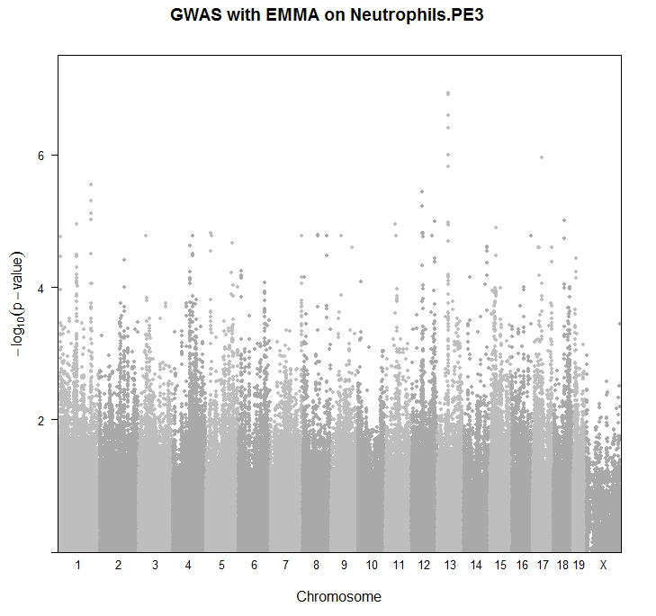
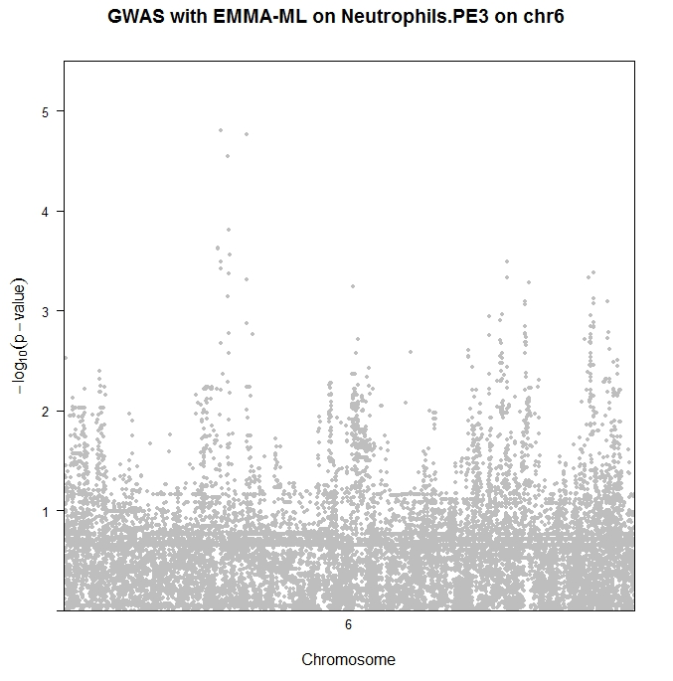
PMN – NuVar association study
EMMA effort

Slide 20
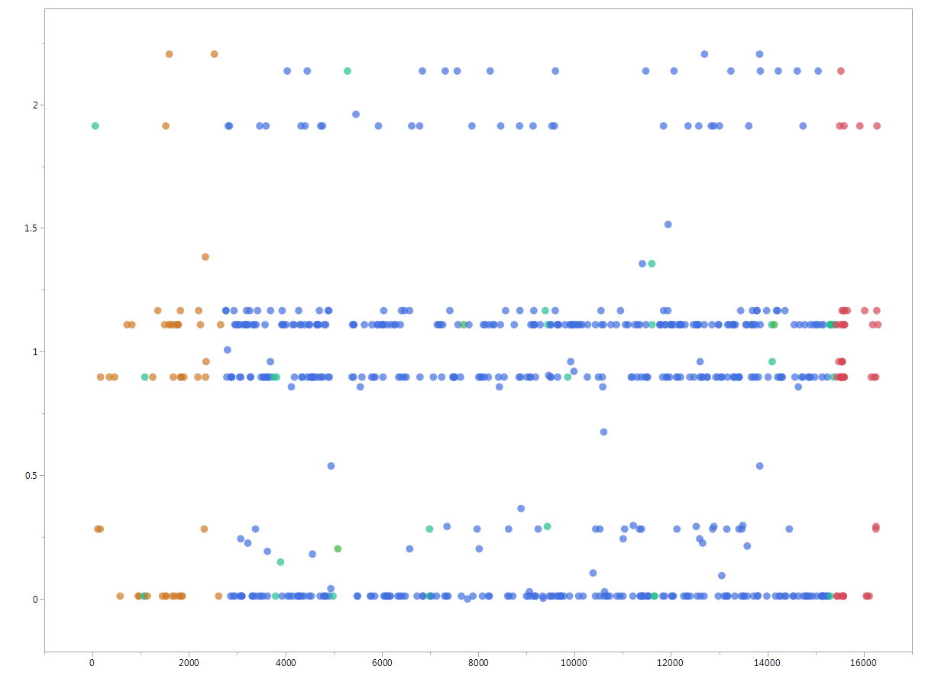
PMN-PE3 with 655 MitoVar
rRNA
tRNA
Protein coding
D-loop
Non-coding
-Log₁₀ P
Mitochondrial chromosome position
Notes:
These are nominal p-value, no p-value correction can be applied
Top 4 MitoSNPs
Top 4 + 16 other “significant” MitoSNPs

Slide 21
Get to know what we do not know
Knowing the main effects:
Significant association results with NuVar
Very few significant association results with MitoVar
We do not know:
Is there any interaction between NuVar and MitoVar?
Especially when neither main effects are significant?
A third option was proposed – coupling the genotypes
Is it doable to model the interaction?
When there are ~450k NuVar and ~655 MitoVar
It is almost 300 million tests!
Our strategy
Divide and conquer

Slide 22
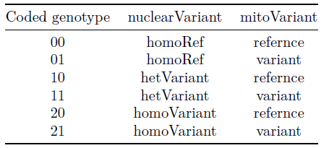
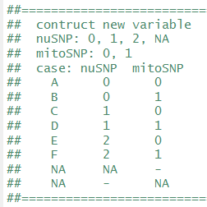
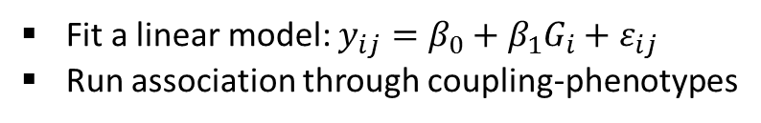
Extend what we have known -- the third option
nuSNP (~600k)
03/31/2017
Mito-protein coding genes only
MitoCarta SNPs
(~12K)
TAGSter (Xu, Z. et al)
LD method: CLD
LD cut off: 0.8
MAF cut off: 0.05
Max distance: 500K
MitoSNP
(665)
Tagged SNPs
(4495)
Coupling the genotypes
Newly constructed genotypes 2985850
Fit a linear model: ${y_{ij}=β}_{0}+β_{1}G_{i}+ε_{ij}$
Run association through coupling-phenotypes
Notes:
Tackle the interaction separately

Slide 23
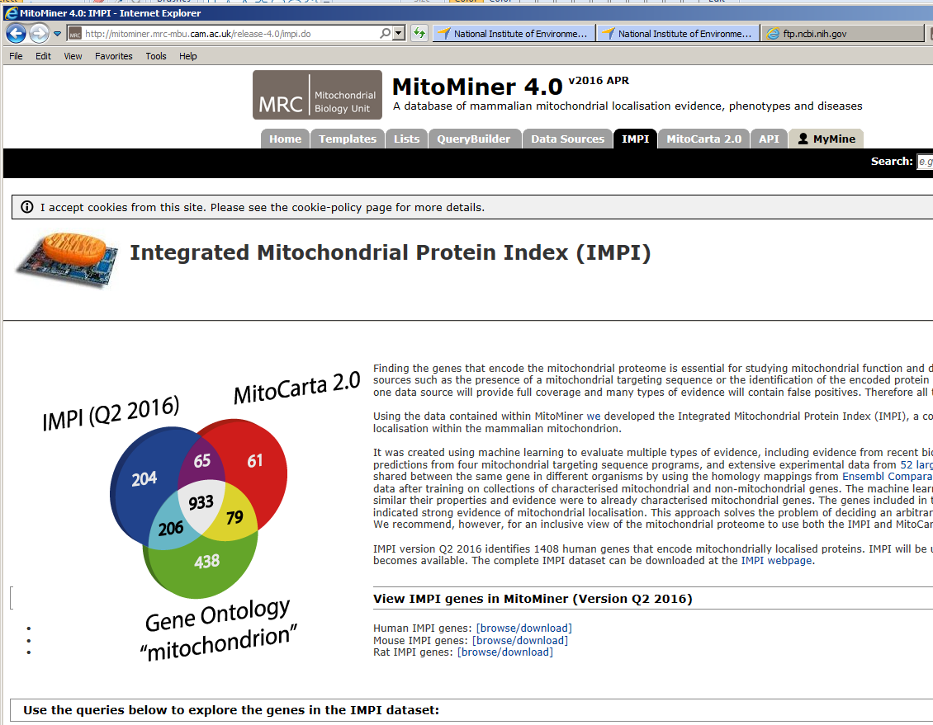

Slide 24
Getting nuclear SNPs (related to mitochondrial function)
With MitoCarta2.0 (1158 genes)
Extract chromosome coordinates (mm10)
Update NuVar panel by lifting the genomic coordinates
Update SNPs that fall within these regions to include
Padded 5kb up/down stream
Possible SNPs with function
Cis-function SNPs
12,689 SNPs were updated and retained
A few cases for SNP annotation update
New annotation added
Updated annotation

Slide 25
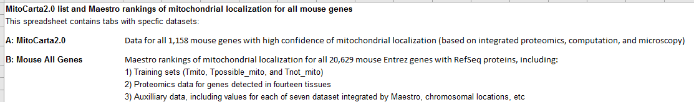
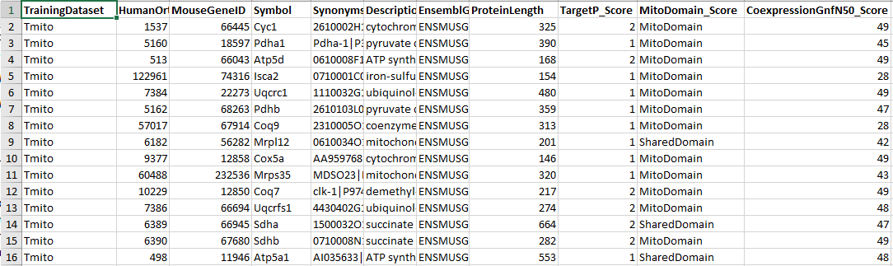
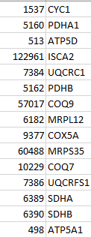
Getting the human homologs --MitoCarta2.0 (1158 genes)

Slide 26
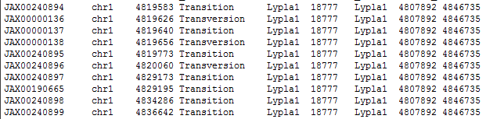
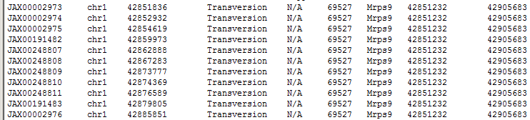
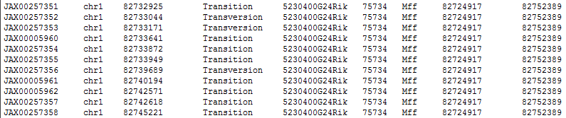
Jax.SNP.ID Chr Position Mut-Type InitAnnot EntrezID MitoAnnot GeneStart GeneEnd
Matched annotation
Jax.SNP.ID Chr Position Mut-Type NOAnnot EntrezID MitoAnnot GeneStart GeneEnd
Jax.SNP.ID Chr Position Mut-Type OLDAnnot EntrezID MitoAnnot GeneStart GeneEnd

Slide 27
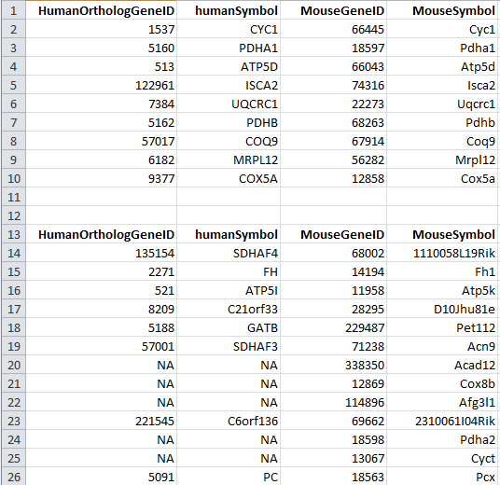
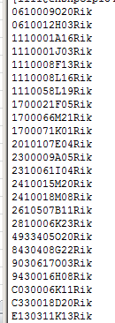
More about annotations
Total 1103 unique “GeneSymbol” annotated
Two bac-clones
BC003965
BC026585
24 Riken genes
1072 matched gene symbols
86 not-matched gene symbols

Slide 28
Tagging the SNPs
TAGster: Single or Multi-Population Tag SNPs Selection, Evaluation and Visualization
Developed by Xu, Z et al – Epidemiology/NIEHS (Bioinformatics. 2007 23:3254-5. Epub 2007 Sep 7)
Main parameters:
LD computation: CLD
LD cut off: 0.8
Max distance: 500K
MAF: 0.05
Total 4495 SNPs selected
https://snpinfo.niehs.nih.gov/snpinfo/selegene.html

Slide 29
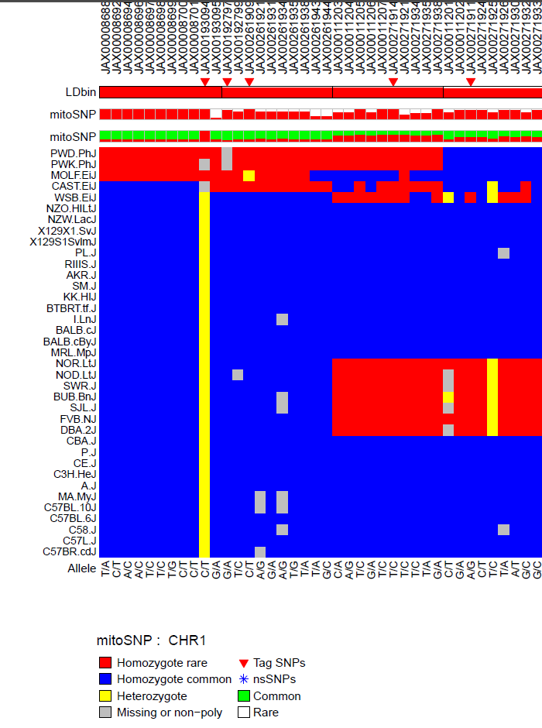
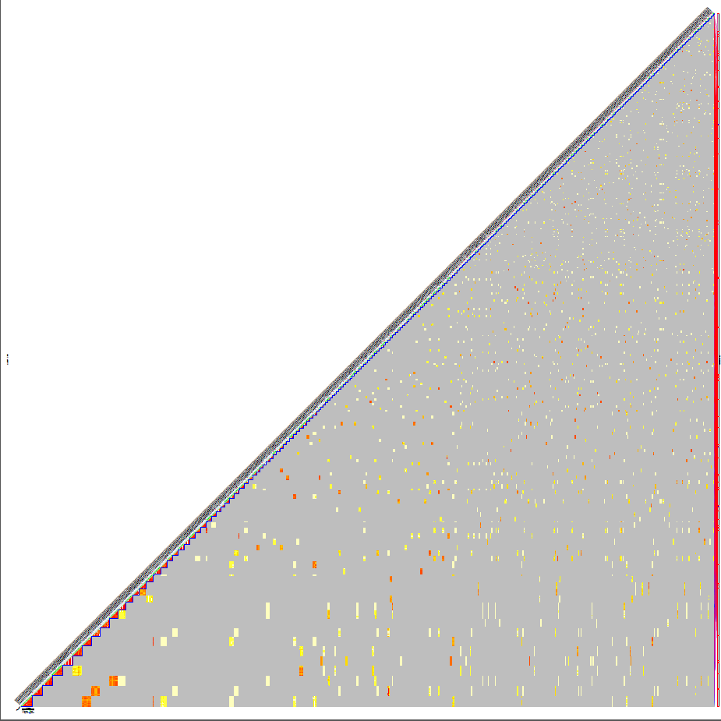
TAGSter results (chromosome 1 and more)

Slide 30
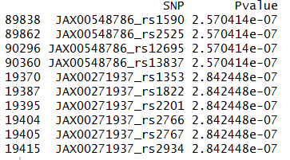
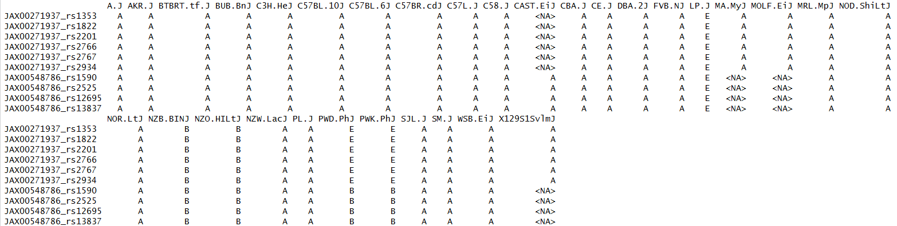
With the coupling_genotypes --neutorphils.PE3
Limited genetic variability
Blocks of same “genotypes”

Slide 31
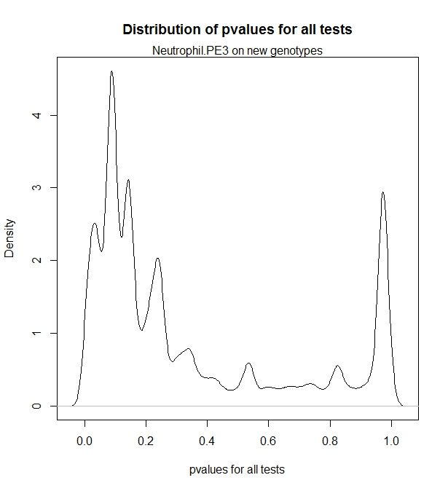
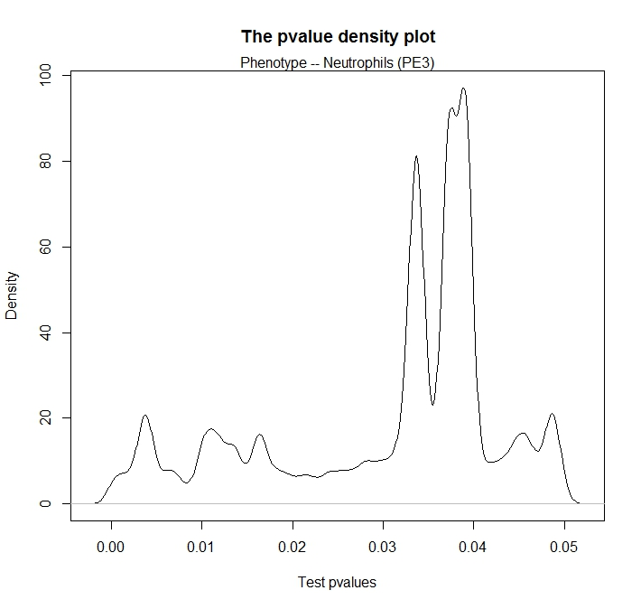
Linear association – neutrophils --pvalue distribution
Top 464,931 tests (p < 0.05)
All 2,985,850 tests

Slide 32
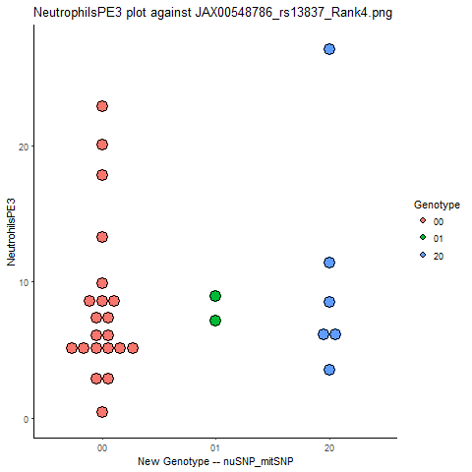


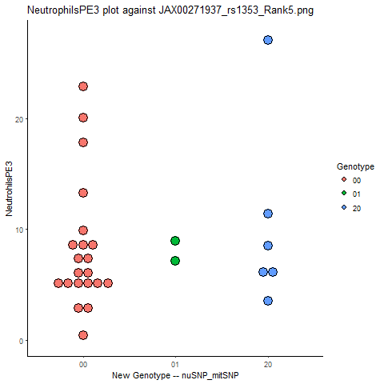
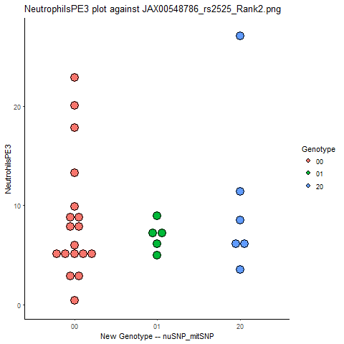





Top 10 hits association --neutorphils.PE3

Slide 33
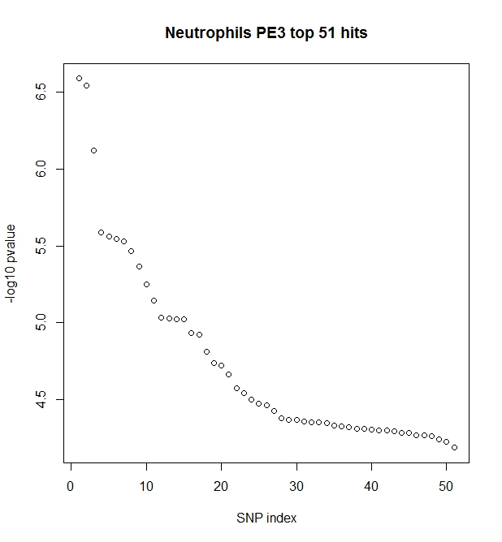
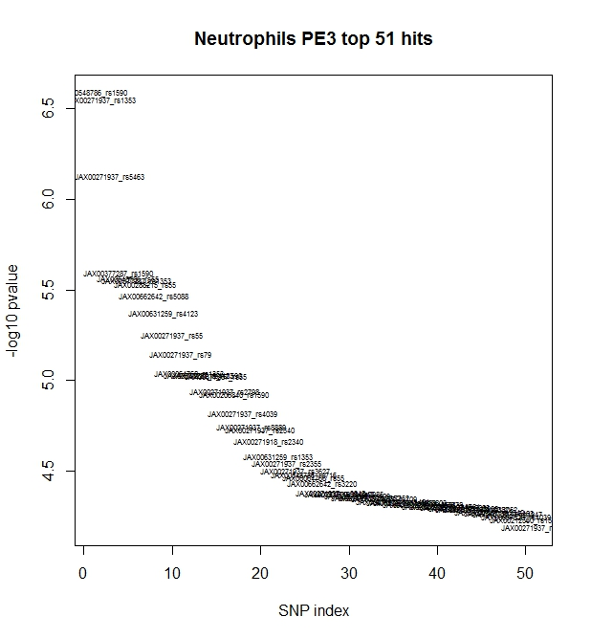
Focusing on the top hits
Take the top 1000 significant results (a subset)
Retain only the coupling_genotypes (unique results)
Resulted in 51 unique hits
Examine the results
Against results with NuVar and MitoVar

Slide 34
Main effect vs. interaction

Slide 35
Significant hits from the interaction
Nominal p-value range: [6.536e-05, 2.570e-07]
Coupling genotypes | 51
Unique NuVar | 12
Unique MitoVar | 31

Slide 36
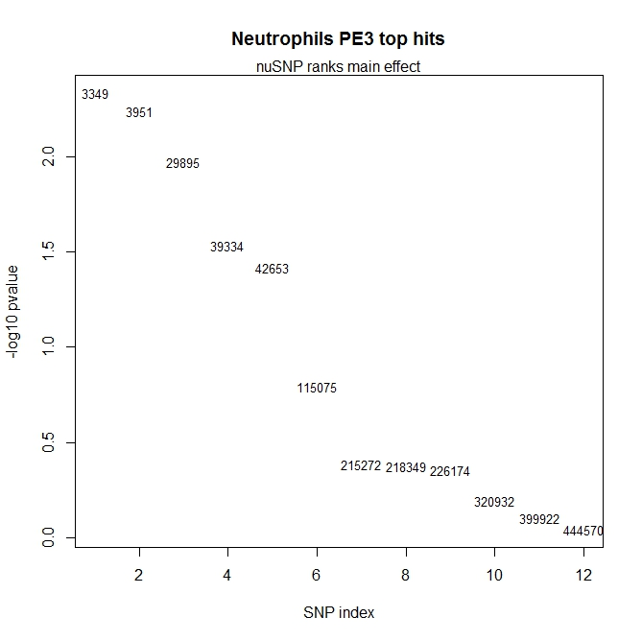
NuVar by itself as the main effect
Index | Rank | nuSNP | pvalue
1 | 3349 | JAX00662642 | 0.004638
2 | 3951 | JAX00631259 | 0.005757
3 | 29895 | JAX00271937 | 0.010659
4 | 39334 | JAX00548786 | 0.029512
5 | 42653 | JAX00064768 | 0.038348
6 | 115075 | JAX00271920 | 0.160508
7 | 215272 | JAX00206840 | 0.413871
8 | 218349 | JAX00637526 | 0.422389
9 | 226174 | JAX00288215 | 0.442335
10 | 320932 | JAX00377287 | 0.639105
11 | 399922 | JAX00271918 | 0.791989
12 | 444570 | JAX00212360 | 0.906992

Slide 37
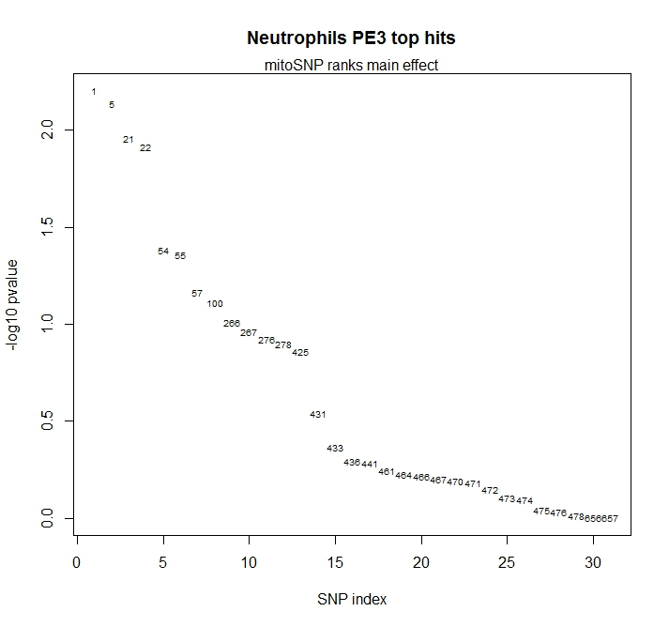
MitoVar by itself as the main effect
Index | Rank | mitoSNP | pvalue
1 | 1 | rs1590 | 0.006264
2 | 5 | rs4039 | 0.007327
3 | 21 | rs5463 | 0.010962
4 | 22 | rs55 | 0.012217
5 | 54 | rs2340 | 0.041336
6 | 55 | rs11404 | 0.044045
7 | 57 | rs1353 | 0.068156
8 | 100 | rs716 | 0.077685
9 | 266 | rs2798 | 0.0982
10 | 267 | rs2355 | 0.109639
… | … | … | …
27 | 475 | rs4942 | 0.907091
28 | 476 | rs9063 | 0.933266
29 | 478 | rs13803 | 0.968171
30 | 656 | rs9348 | 0.991218
31 | 657 | rs7778 | 0.997587

Slide 38
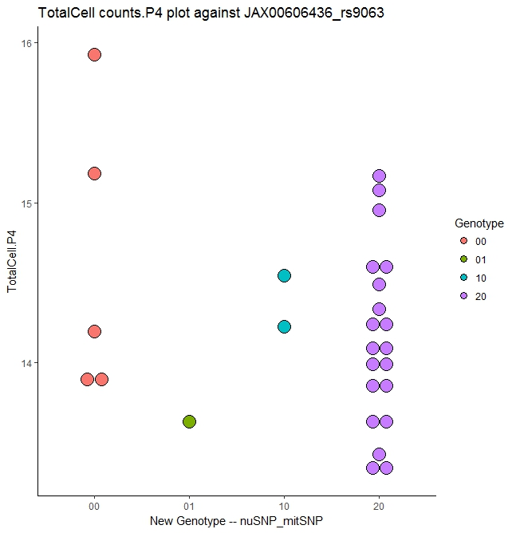
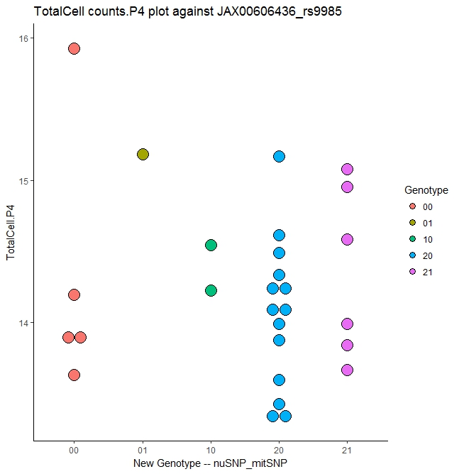
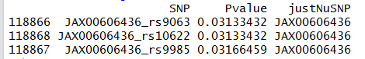
The top hit with totalCellsP4
-- JAX00606436 (lme4 -- Bushel)

Slide 39
Trimming those blocks of same “ genotypes”

Slide 40
Trimming the coupling genotypes --Retaining the informative genotypes

Slide 41

nuSNP (~600k)
03/31/2017
Mito-protein coding genes only
MitoCarta SNPs
(~12K)
TAGSter (Xu, Z. et al)
LD method: CLD
LD cut off: 0.8
MAF cut off: 0.05
Max distance: 500K
MitoSNP
(665)
Tagged SNPs
(4495)
Coupling the genotypes
Newly constructed genotypes 2,985,850
Retain informative
Final informative CoupVar
(113,691)
Fit a linear model: ${y_{ij}=β}_{0}+β_{1}G_{i}+ε_{ij}$
Run association through coupling-phenotypes

Slide 42


Correcting the p-values

Slide 43





Slide 44
Conclusion
Systematic trimming SNP successfully
Alleviate computation stress
Limit the number of tests
Allow p-value correction
Coupling NuVar and MitoVar renders a novel approach to capture the “interaction”
With “Neutrophils” as the phenotype
Significant interactions revealed, although
Neither main effect was significant*
With “TotalCell counts P4” as the phenotype
A significant main effect does not ensure that the interaction stays significant
Future direction
Examine and evaluate the modeling
Incorporating the possible covariates
Follow up (biology)
*Except for the top mitoSNPs, rs1590, rs4039

Slide 45
We have learned what we do not know
Some unknown become known ☺
How much unknown do we still not known
I do not think I know ☺

Slide 46
Acknowledgement
Dr. Kleeberger Lab
Drs. Pierre Bushel, Min Shi, and Claire Weinberg
Dr. Sara Grimm
Y’all

